Slide 1
Recent advances in Infertility Diagnostic Modalities
SIG Endocrinology 2019
Chairperson – Madhuri Patil

Slide 2


Tests
Techniques
Technology
Drugs
Protocols
Have been developed
‘In Quest to’
Improve Ovarian response
Endometrial receptivity
Implantation potential of embryos
PR’s in IVF

Slide 3


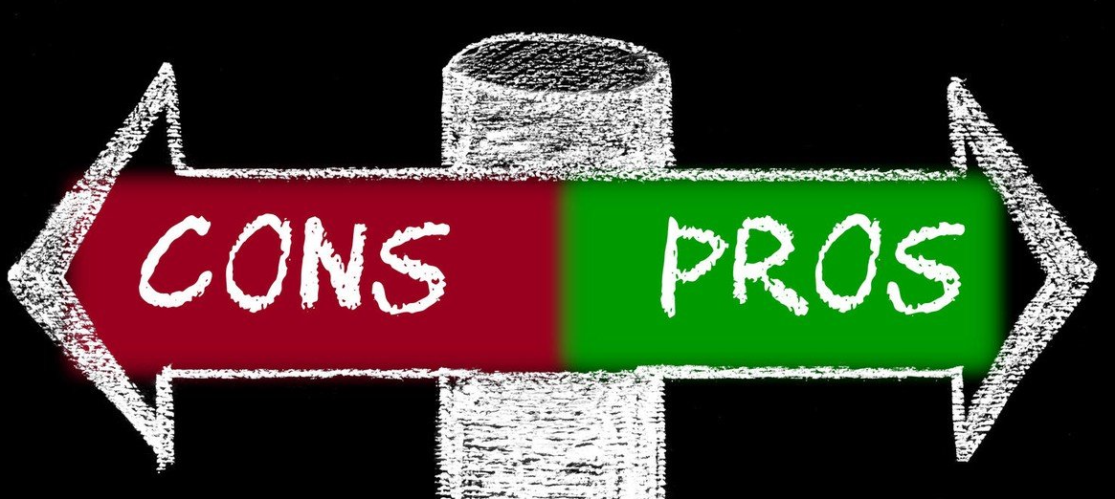
When implementing advanced tests and technology in ART
As Effectiveness
    Safety
    Side effects
    not validated

Slide 4
New Tests in ART
AMH
DFI
Endometrium – ERA
New techniques to assess oocytes and embryos

Slide 5
AMH
Actions of AMH in Ovary
Produced by the granulosa cells of small growing follicles
highly expressed in cumulus cells
Inhibits
initial follicle recruitment – Regulates transition of primordial to primary follicle
FSH-dependent growth and selection of pre-antral and small antral follicles
Down-regulates the aromatizing capacity of GC

Slide 6
AMH and Ovarian Reserve – Benefits
AMH tells about
Ovarian Reserve, which correlates with AFC
Number of oocytes after COH for IVF
AMH does not tell...
Time to Pregnancy
Natural fecundability
Current Fertility - Natural or IVF
Time left to Menopause ???
60% from follicles with diameters of 5–8 mm
25% from follicles with diameters of < 5 mm
15% from follicles with diameters of 8-10 mm

Slide 7
AMH in ng/ml
Sensitivity - 97% for predicting Response
AMH may not be constant over entire cycle so measurement on Day 2 or 3 would be ideal
>3.5
chance of hyper-response
higher risk of OHSS
1.26 – 3.5
Normal response
With higher dose of GT can still cause OHSS
0.7- 1.25
Poor response (<4)
IVF - first option
May require higher dose of GT and take longer time to achieve dominance
Oocyte or embryo pooling
< 0.7
Very Poor response (<2)
IVF - first option
May require higher dose of GT and take longer time to achieve dominance or may not respond
Oocyte donation

Slide 8
Disadvantage
All do not use automated assay still
No international reference standard for AMH
Data to be validated to redefine threshold with new assay(s).
Normative data not established in adolescents
Confounders: OCP use, ethnicity, smoking, chronic disease
Advantages
Earliest marker to change with age
Least inter and intra cycle variability
Can be randomly measured during the cycle
No change with the use of GnRh agonist
No change in hypothalamic amenorrhea
AMH correlates with age and AFC

Slide 9
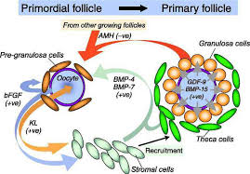
AMH helps in Fertility counseling
Helps Counselling regarding treatment protocols, response and success of treatment, Risk of OHSS and POR
Improve safety of IVF
Predictive accuracy in relation to IR, CPR and LBR limited
False reassurance (false positive findings)
Unnecessary anxiety (false negative findings)
Premature actions towards fertility treatment
Counselling for FP in women with recurrent endometriomas
Counselling for FP in cancer patients
How long to postpone childbearing?
Gives estimate of their reproductive potential

Slide 10
Sperm DNA Fragmentation Evaluation
Basic Semen Analysis – Information about the messenger
Sperm DNA integrity tests – Reveal information about the message

Slide 11
Sperm DNA damage
Alteration in Chromatin structure
DNA fragmentation
DNA oxidation
Protamine Deficiency
Seen in form of
production of sperms
or the
transport of sperms
Infertile men have higher levels of sperm
DNA – chromatin damage than fertile men

Slide 12
Indications for Testing
The test should be offered before IVF/ICSI to male partners of couples with a history of:
Unexplained or persistent infertility
Failure to conceive after 5- 6 IUI cycles despite good count and motility
Low fertilization rates or poor embryo quality in IVF cycles
Implantation failure after IVF
Recurrent miscarriage
Prolonged stay in an environment that exposes to reproductive toxins
Abnormal semen Analysis
Advancing male age (> 45 years)

Slide 13
Detection of sperm DNA damage
Single cell
gel electrophoresis
Indirect test for DFI
deoxynucleotidyl transferase –mediated Dutp nick end labeling
30% and higher DFI low to poor fertility potential

Slide 14
Advanced paternal age
Genetic Inheritance
Mutations
CABVD
Robertsonian translocations
Y chromosome deletion
Causes of sperm DNA damage
Life style
Diet
Cigarette Smoking
Alcohol
Recreational drugs
STIs
Injury
Infection
Obesity
Use of mobiles
Environment
Endocrine disruptors
Xenoestrogens
Anti-androgens
Toxic compounds
Hormonal deficiency
  Varicocele
Protamine deficiency
Occupation
Plastics & resins
Solvents
Wood processing
Metal industry
Automobile, truck & aircraft mechanics
Sedentary or stressful jobs
Exposure to WIFI

Slide 15
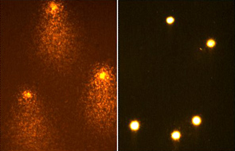
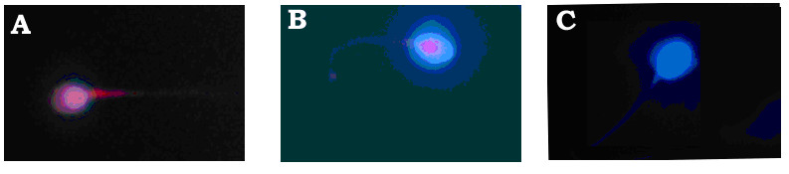
Evidence linking sperm DNA fragmentation to poor reproductive outcome
It has Impact on embryo/blastocyst development, progress of pregnancy and pregnancy loss
Can also have impact on health of the baby born
Dominant genetic mutations- Achondroplasia and Apert Syndrome
Neurological Disorders -Schizophrenia , Autism and Bipolar disorder
Disease & Birth defects- Neural tube defects, Epilepsy, Huntington disease and Down’s Syndrome
Sheena EM Lewis, Asian J Androl. 2015 Jul-Aug; 17(4): 616–622., Feinberg, J. I.,et al 2015. International journal of epidemiology, 44(4), 1199-1210.; Jenkins, T. G., et al 2014. PLoS Genet, 0(7), e1004458.; Simon, L., et al 2010. Hum Reprod

Slide 16
Poor quality sperm with high DFI = Reduced
Implantation rate
Embryo development
FR
CPR
LBR
Post-implantation loss and malformations
Childhood health
ASRM committee guidelines
Do not support routine & widespread use of sperm DNA damage testing to predict pregnancy or pregnancy loss (Level C)

Slide 17
Treatment Options
Antibiotics for semen infection
Vitamin ( Antioxidant) supplementation
Vitamins C, E
Selenium
Folate
Zinc
(Fraga et al 1992, Greco et al 2005 Menezo et al 2007 Silver et al 2005
Minimize exposure to gonadotoxins hyperthermia
Eg – smoking, medication, saunas, hot tubs
Varicocelectomy
Zini et al 2005 Werthman 2007 Chen et al 2008
ICSI with testicular sperm
CPR 44 % ( 8/18) in patients
with > 15 % sperm DNA damage
Greco et al 2004

Slide 18
Fertility Counselling
Contradictory evidence for utility of sperm DFI in predicting reproductive outcome
Target group for testing in a clinical setting remains unclear
Repeated ART failure?
Repeated miscarriage?
Unexplained or persistent infertility?
Low fertilization rates or poor embryo quality in IVF cycles?
Prolonged stay in an environment that exposes to reproductive toxins?
Advancing male age (> 45 years)?
Even if DNA integrity test suggests that sperm may be more or less likely to result in pregnancy or miscarriage, we still have no way of translating that knowledge into useful clinical outcome
To date - no reliable approach to completely filter out spermatozoa with DNA strand breaks
Zini et al., 2000; Gandini et al., 2004; Stevanato et al., 2008; Ebner et al., 2011; Bach 2016.

Slide 19
The effect of DNA damage in sperm on ART outcome is a mixture of the damage itself + oocyte ability to repair
If we do not test for DFI and our traditional tests prevail
It will prevent an improvement in our success rates in the diagnosis and treatment of male infertility
We need to analyze
Which is greater: Risk or Benefit of testing for DFI?
What is in the best interest of the infertile couple?
Sperm DNA testing is a useful adjunct to semen analysis for routine fertility management
May contribute to the development of novel and more personalized approaches to test and treat male factor infertility

Slide 20
Endometrial Receptivity
It is Endometrial lining in a state of readiness
for blastocyst implantation
Suprapysiological concentrations of E2 in IVF
Disturbance in embryo–maternal dialogue
Endometrial dysfunction may be the cause of reduction in cycle fecundity noted in some women
Disturbance in embryo–maternal dialogue due to difference in maturation and synchronization of endometrium
Premature secretory changes (maturation advancement exceeding 3 days)and Dyssynchronous glandular and stromal differentiation in the mid-luteal phase

Slide 21
Gene Expression Profiling During the WOI by
Endometrial Receptivity Array (ERA)
Can determine the endometrial receptivity by the identification of the transcriptomic signature composed by the expression of 238 genes
Profile differences are implemented in a computational predictor that can diagnose objectively the personalized WOI
Diagnose abnormalities in the endometrial response - Sufficient progesterone and
  Appropriate timing
Reproducible as occurs in every cycle

Slide 22
Endometrial Receptivity Array (ERA) Timing of the biopsy

Slide 23
Clinical algorithm for ET personalization
After ERA all ETs should be done in FET cycle

Slide 24
Advantages
Identifying WOI displacements in RIF
introduces the concept of personalized ET
to treat endometrial pathology that may be the result of individual physiological variation
Limitations
Biopsy material required
Cannot be carried out during the treatment cycle
Gene expression studies cannot be extrapolated to protein expression
Expensive
Endometrial Receptivity Array (ERA)
Couples with RIF, previous failed IVF cycles, RPL may benefit with ERA but needs to be validated
M. Ruiz-Alonso et al., 2014; M. Enciso et al 2018

Slide 25
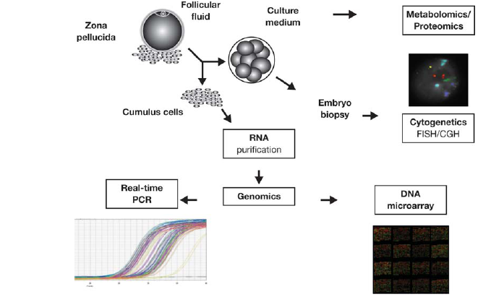

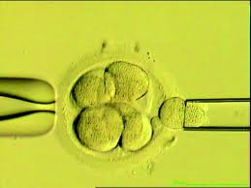
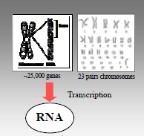
New techniques for assessment of oocyte and embryo quality
In Addition To Morphology DNA, RNA, Protein Or Metabolite Profiles

Slide 26
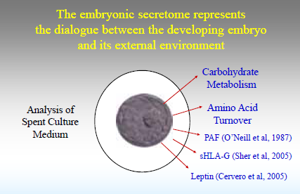

Slide 27
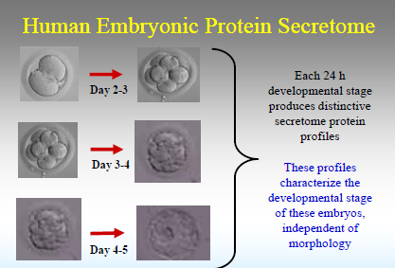

Slide 28
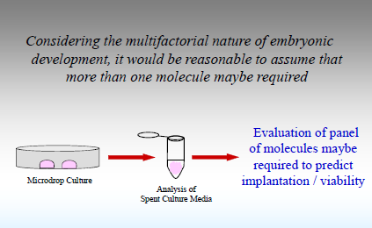

Slide 29
Technique to assess embryo quality
Preimplantation Genetic Screening (PGS)
> 40 yrs
Repeated Implantation Failure
Male Infertility
Recurrent Miscarriage
Increased risk of trisomy
Increased risk of miscarriages

Slide 30
Methods of PGS
Preimplantation Genetic Screening (PGS)
Fluorescent In Situ Hybridization (FISH)
Array Comparative Genomic Hybridization (CGH)
Next Generation Sequencing (NGS)
- Recent technique

Slide 31
PGS
PROS :
Time to pregnancy decreased
Decreased risk of miscarriage
CONS :
More RCTs required
Embryos may auto correct
Mosaicism – confusing the issue of transfer

Slide 32
Before we implement these new tests important to
Determine cost effectiveness
Evidence for proven benefit
Be aware of patient demographics
Are we causing any potential harm?
Long term follow up the children

Slide 33
Important to
Evaluate feasibility to implement from basic discoveries into clinical applications
Determine if these advances improve efficiency of IVF
Should not be marketed prematurely based on inconclusive trials
Couple must clarify any information they are unsure about - medical and financial implications

